Slide 1
01 - Project Life Cycles
ITPM5.248 Agile Projects

Slide 2
Overview
Project life cycle
Software life cycle process
Stakeholder Register
Project Charter
Constraints and Requirements

Slide 3
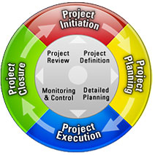
Project Life Cycle – Steps
Initiation
Planning
Execution
Closure

Slide 4
Project Life Cycles – Introduction
The way you organise the work.
Can be gated or iterative.
It’s important to be pragmatic about your approach.
Life cycle depends on both customer and organisational risks.
Notes:
There is no one-size-fits-all solution.
Projects are almost guaranteed to not go according to the original plan.

Slide 5
Software Development Project – Typical Steps
Initiation
Planning
Execution
(include monitor & control)
Closure
Requirements
Design
Development
Testing
Deployment
Maintenance
Disposal
ISO/IEC/IEEE 12207:2017 Software Life Cycle Processes
SWEBOK v4.0

Slide 6
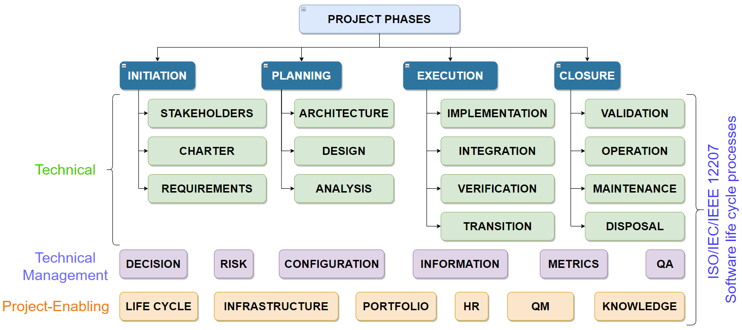
Software Life Cycle Step 1: Initiation
We are here…

Slide 7
Step 1. Project Initiation
Definition To define the processes needed to start a new project.
Purpose
To determine what the project should accomplish.
Main Activities
Identify the Stakeholders
Develop a Project Charter

Slide 8
Identifying Stakeholders
A stakeholder can influence the success and failure of the project.
A Stakeholder Register is used to record the stakeholder information, for example:
Stakeholder type.
Stakeholder expectations.
Project roles (Business Analyst, Tech Architect, Client PM).
Designation (Director, Business Lead, etc.).
Type of Communication (Weekly/Monthly).
Influence on the project.

Slide 9
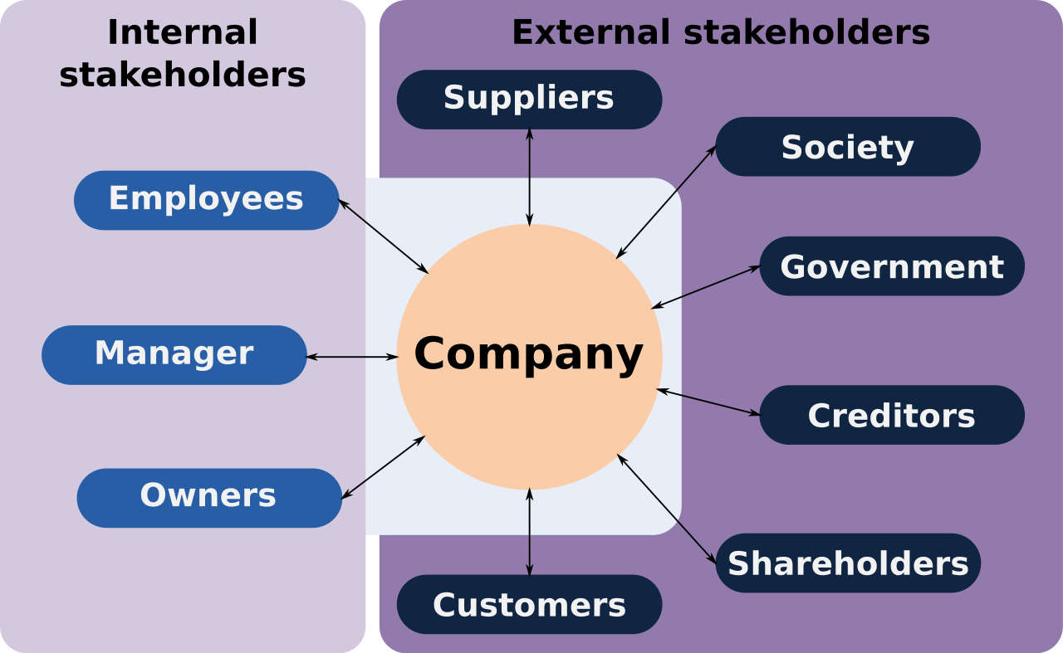
Types of Stakeholders

Slide 10
Stakeholder Register – Parts
Stakeholder’s identification
Group name, location, and contact details
2. Stakeholder’s assessment information
Role in the project
Major requirements or expectations
3. Stakeholder’s classification
Internal or external
Classified (based on their influence and impact on the project

Slide 11
Stakeholder Register – an example
Stakeholder name | Title | Role | Power (H/L) | Interest (H/L) | Requirements | Communication
Eddie Murphy | Security Manager | Sponsor | H | H | Finish implementing GDPR compliant checkouts by end of Q3 | Weekly via email
Lliza Shlesigner | Senior Developer | Developer | L | H | Security certificates
Bill Burr | CEO | - | H | L | 5% revenue increase
Dave Chapelle | Accountant | - | L | L | -

Slide 12
Project Charter
Project Charters are used as the project’s vision, mission and success criteria.
Generally, a project charter will include:
Business value (Why?...the vision)
High-level requirements (What and How? …mission)
Stakeholders (Who?...mission)
Constraints
Risks
Budgets
https://www.smartsheet.com/blog/project-charter-templates-and-guidelines-every-business-need
Notes:
This document allows a project manager to use organisational resources for the project.

Slide 13
Create Project Charter
Understand project goals and objectives
Identify the project vision and determine the scope
Define project organization
List all of the essential roles for the project:
e.g.: customers, stakeholders & development team.
Create an implementation plan
Outline major milestones, dependencies and timeline for all stakeholders.
List potential problem areas
Highlighting risks will help everyone think ahead, should the worst happen.
Requirements
Include software requirements review (e.g., elicitation, analysis, specification, and validation) (SWEBOK ch9 1-1)

Slide 14
Iron Triangle (model of constraints)
Scope & Resources
Quality
Cost
Time
Change in one side MUST affect another side)
Notes:
PM

Slide 15
Drivers, Constraints & Floats
Find out your customer requirements:
wants (feature set)
when (release date) and
how good it needs to be (quality/defects)
List your environmental limitations:
Team (location, skills)
Processes
Budget
These limitations will dictate the scope/quality.

Slide 16
Drivers, Constraints & Floats (cont.)
From environmental limitations list start with this question:
What is most important for project success?
This is the driver
Prioritise the remaining items, and pick the top 2 or 3:
These are you real constraints
Your floats are the next few lower priority and more flexible items.

Slide 17
Drivers, Constraints & Floats (cont.)
Ideally you should have:
1 driver
1 constraint
4 floats
More drivers and constraints make the project less likely to succeed.

Slide 18
Examples of Constraints
Time & Budget
Interfaces to other systems
Physical Size
Laws
Pre-existing technology
User/Operator capabilities

Slide 19
Other Project Initiation Processes
Assigning the project manager.
Determining the stakeholder needs expectations and high-level requirements.
Define the project success criteria.
Identify particular budget for particular stage.
Make sure that the project is aligned with the organisation's strategic goal.
Notes:
The project charter and stakeholder register are used as inputs to the next steps.

Slide 20
Requirements
State system performance, or “what‐is‐necessary”.
Not how to perform a task, unless it’s necessary for the proper functioning of the product.
Should be expressed in a positive way.
Be a complete sentence (with a verb and a noun).

Slide 21
Requirements (cont.)
A well-formed requirement is a statement that:
is verifiable
solves a stakeholder problems/objectives
is measurable and bounded
defines performance of a system under specific conditions but does not define the capability of the user, operator, or other stakeholder.

Slide 22
Requirements (cont.)
According to ISO/IEC/IEEE 29148:2018, must be:
necessary
implementation-free
unambiguous
consistent
singular
feasible
traceable
Verifiable

Slide 23
SWEBOK - Software Requirements
Formally, a software requirement has been defined as:
a condition or capability needed by a user to solve a problem or achieve an objective;
a condition or capability that must be met or possessed by a system or system component to satisfy a contract, standard, specification or other formally imposed document

Slide 24
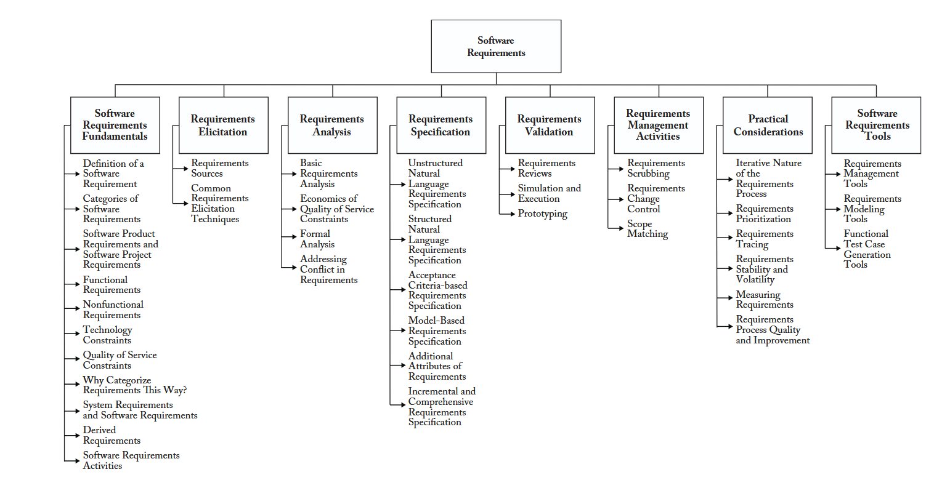
SWEBOK - Software Requirements (cont.)

Slide 25
Behavioural
Functional
Customer
Structural
Design
Architectural
Performance
Derived
Allocated
Requirement Types

Slide 26
Language of Requirements
Use “shall” for requirements.
Use “should” for recommendations/ preferences.
Use “may” for permissions/suggestions.
Use “can” for possibilities or capabilities.
Use of “will” should be avoided for legal reasons.

Slide 27
Language of Requirements – Avoid:
Language | Examples
Open-ended statements | shall be included but not limited to
Loopholes | relevant, necessary, appropriate
Ambiguity | as far as possible, optimise, minimise, maximise
Vagueness | typical, satisfactory, adequate, sufficient, enough, suitable
Subjectivity | rapid, quick, user‐friendly, easy, small, large
Superlatives | great, first rate, best possible, state of the art
Negativity | don’t specify what you don’t need

Slide 28
Examples of Requirements
[Condition] [Subject] [Action] [Object] [Constraint]
When signal x is received [Condition], the system [Subject] shall set [Action] the signal x received bit [Object] within 2 seconds [Constraint].
[Condition] [Action or Constraint] [Value]
At sea state 1 [Condition], the Radar System shall detect targets at ranges out to [Action or Constraint] 100 nautical miles [Value].
[Subject] [Action] [Value]
The Invoice System [Subject], shall display pending customer invoices [Action] in ascending order [Value] in which invoices are to be paid.

Slide 29
Software Life Cycle Step 2: Planning
We are here…

Slide 30
2. Project Planning
Definition To enable tracking of process and increasing collaboration.
Purpose
To determines the scope of the project as well as the objective of the project.
Main Activities
System analysis and design.
Notes:
It begins with the outputs of the initiation phase (charter, preliminary scope statement, and project manager).
The output of the planning phase serves as the input for the execution phase.
Planning phase should not be executed before your initial planning is finished
You should not stop revising plans (even during execution)

Slide 31
System Analysis Activities
Define the system analysis strategy
Identify analysis needs & stakeholders
Define scope, objectives, fidelity
Perform the analysis
Identify/validate contexts/assumptions
Review for quality/validity
Establish conclusions & recommendations
Manage the results
Maintain traceability
Establish baselines

Slide 32
System Analysis Outcomes
System analyses needs are identified.
Assumptions and results are validated.
Results are provided to help make decisions.
Any enabling systems or services needed for the analysis are made available.
Traceability of the results is established.

Slide 33
Software Life Cycle Step 3. Execution
We are here…

Slide 34
Step 3. Project Execution
Definition Consists of those activities that are defined in project management plan (action time).
Purpose
Managing stakeholder expectations.
Coordinating people and resources.
Main Activities
Observe development, test and validation.
Make sure deployment are up-to-date.
Notes:
Re-baselining and/or updates to existing project requirements may (and almost certainly will) occur.

Slide 35
Development/Implementation
To realise the software/system elements which satisfy the requirements.
Includes various methods of construction:
Newly built software
Re-use (with or without modification)
Acquisition (e.g. Open Source)

Slide 36
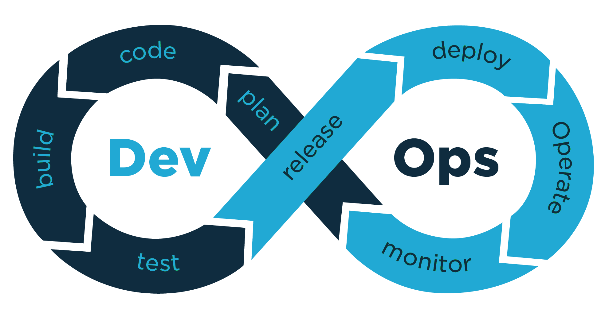
Testing – Integration
Purpose
To synthesise a set of system elements into a realised system (product or service) that satisfies system/software requirements, architecture, and design.
Image Source: https://www.spoclearn.com/dz/devops-courses

Slide 37
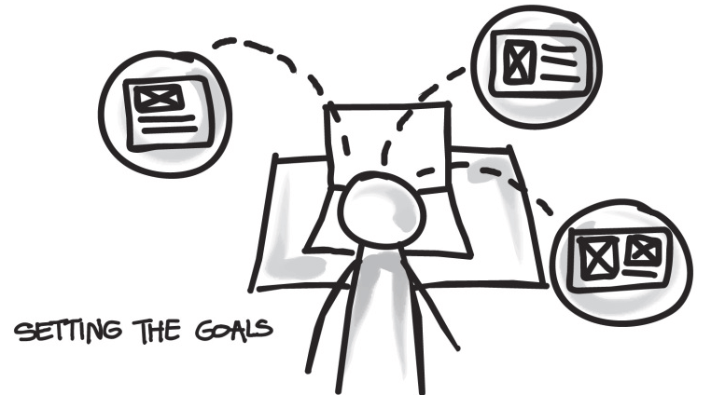
Testing – Verification
Purpose
To provide objective evidence that a system or system element fulfils its specified requirements and characteristics.
Image Source: https://www.lambdatest.com/blog/test-verification-vs-validation-in-website-testing/

Slide 38
Testing – Verification Activities
Define verification strategy
Scope, properties, expectations, priority
Define & execute verification procedures
Manage results
Anomalies & follow-up actions
Incidents/problems, resolution tracking
Stakeholder agreement
Maintain traceability
Baseline data

Slide 39
Deployment – Validation
Purpose:
To provide objective evidence that the system, when in use, fulfils its business or mission objectives and stakeholder requirements, achieving its intended use in its intended operational environment.

Slide 40
Project Review
At the end of the execution phase, a review is done. It helps you to perform the following activities:
Document the result of your project management review
Inform the sponsor about the progress of the project
Identifying any risk or issues that impacted the project
Shows deliverables to stakeholder produced during the project.

Slide 41
Software Life Cycle Step 4: Closure
We are here…

Slide 42
Step 4. Project Closure
Definition The controlled shut down of the project once complete.
Purpose
To formally close a project and authorize the handoff from project to operations
Main Activities
Maintenance & Disposal.
Notes:
Re-baselining and/or updates to existing project requirements may (and almost certainly will) occur.

Slide 43
Maintenance Activities
Define a maintenance strategy
Forecast product/environmental evolution.
Perform maintenance
Review requirements
Correct failures, flaws, errors or replace/upgrade.
Perform logistical support
Monitor changes in supporting infrastructure.
Manage results
Record and track incidents, actions & trends.
Ensure customer satisfaction.

Slide 44
Disposal Activities
There are three main closure elements to be closed:
Product
The customer accepts the final deliverables.
Project
Formally closing out administrative procedures, updating project documents and archiving.
Resources
Financial matters are concluded, resources assigned to the project are released.

Slide 45
Project Life Cycles – Review
Initiation
Requirements
Planning
Design
Execution
Development
Testing
Deployment
Closure
Maintenance / Disposal

Slide 46
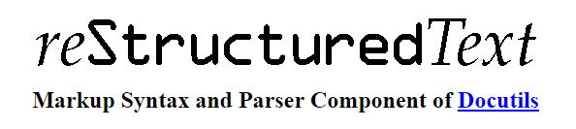
Lightweight markup language used in the Python community for Technical Documentation.
Designed to be processable by documentation generation tools and easily human-readable.
Markdown is based on conventions for indicating formatting in plain text email and usenet posts.

Slide 47

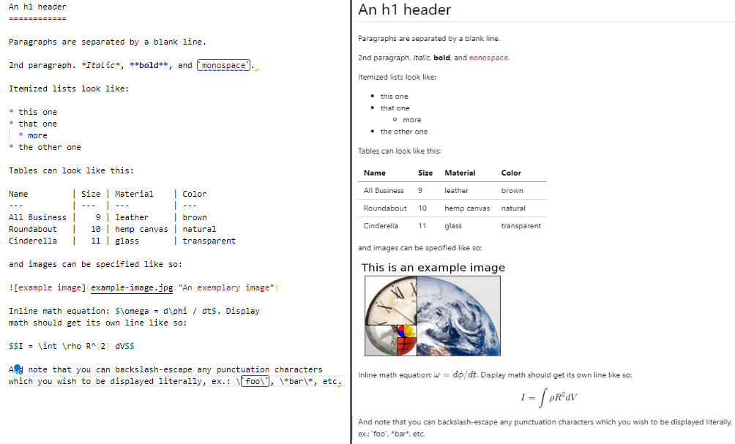
Markdown

Slide 48
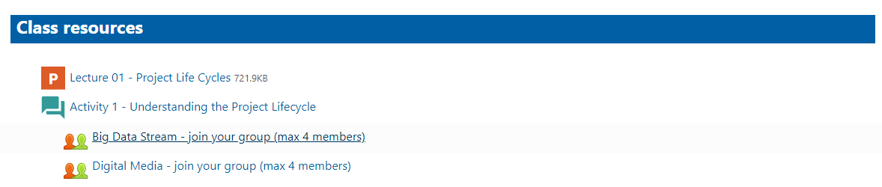
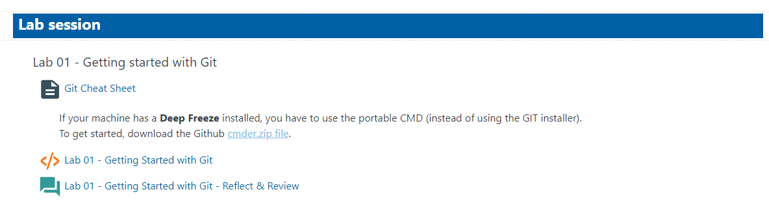
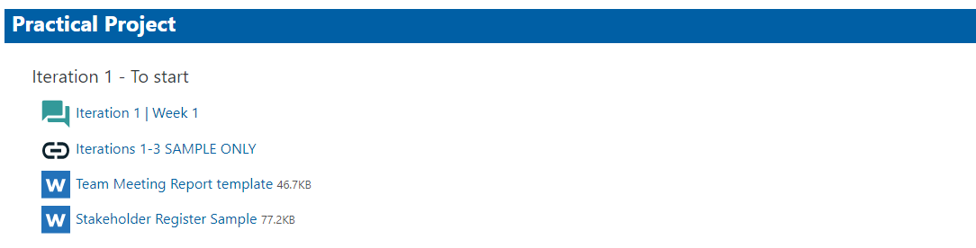
Q&A

